Slide 1

CSC349 User Experience
Practical 4 –Design Crits and Storyboarding

Slide 2

Practical Overview
In this session we will look at:
The concept of the Design Crit
The Storyboarding Technique that we have discussed in lectures
Coffee break!!!
After this we will move on to start to address a real world problem (group)
Revisiting Design Games
Multiple techniques you can implement suggested (group)

Slide 3
Design challenge 1:
Home Automation (Individual, 15 minutes)
Modern technology to support Smart Homes is interesting but underdeveloped, typically being seen as a niche market for “techy-types”. You are being asked to address this problem by rethinking the classic approach to home automation and making it more accessible. Produce 10 (or more) sketches on this area.
Assumptions
You have access to a range of sensors
You can rebuild products to automate them or refit them with automated elements

Slide 4
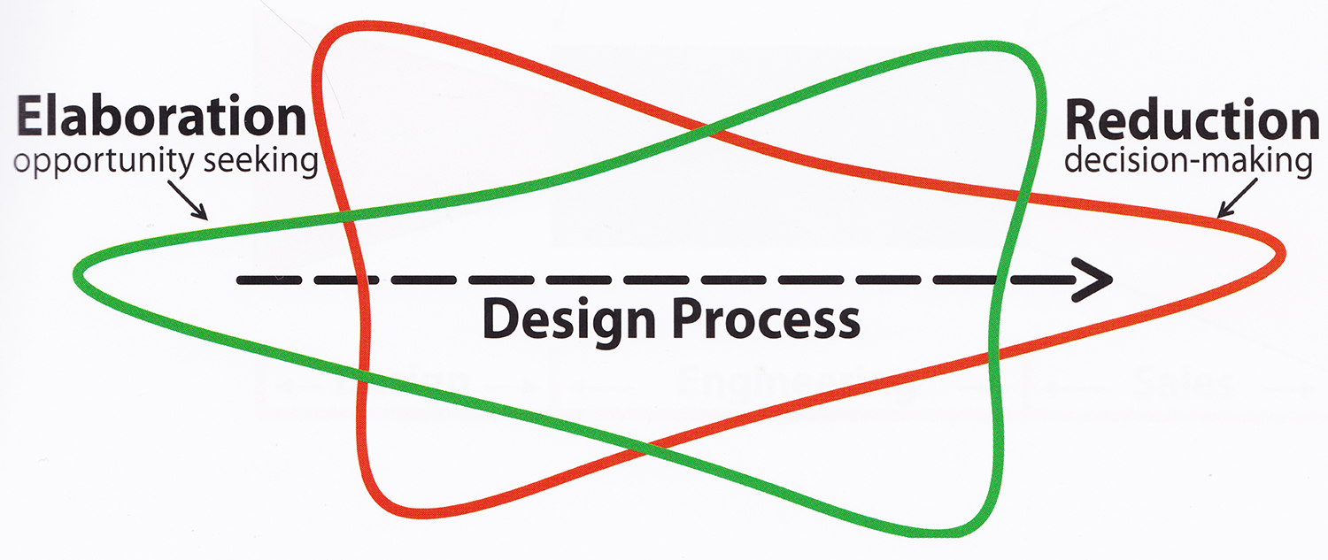
Reminder: The design funnel
Notes:
Then what happens? We have a raft of issues to address
three's no clear cut law of emergence vs. convergence

Slide 5
Design challenge 1:
Selection and elaboration (Individual, 15 min)
Chose the most promising design concept as a staring point
Produce 10 details and/or variations of that particular design concept
Detail what exactly the people involved have to do
Try out slight variations on your concepts
Don’t limit your thinking yet
Remember, your designs are to evoke or guide an experience with the device, what is that experience going to be?

Slide 6
Design challenge 1:
A Formal Design Crit
Previously we have looked at and shared ideas with other people but this time round you will, in your groups, do a formal Design Crit exercise.
Design Crits are group sessions where each member of a team in turn presents their designs and their process for detailed feedback and criticism
Emphasize high level user and business goals, and minimize the focus on engineering constraints or aesthetic choices
Individually, prepare 3-4 questions to ask the group for feedback on as well as takin open criticism on the ideas

Slide 7
Design challenge 1:
A Formal Design Crit
What are the important things to remember in a design crit?
Focus on process as much as detail, for example, if you think someone is making a mistake with a decision they have taken, try to critique their underlying logic
Design crits are about improving your ability as much as they are about improving your design
Try to promote creativity in the process, try to open up rather than close of design spaces
Constructive feedback is vital – if you can’t tell them what you like as well as what you don’t like your feedback is essentially worthless
Think compliment sandwich!

Slide 8
Design challenge 1:
A Formal Design Crit (Group, 25 minutes)
Go round the group taking it in turns to present your ideas.
After someone presents, give feedback to them.
Once this is done, the presenter should ask their questions (some of which may already be answered)

Slide 9
Group challenge
You will be working your groups of 6-8 for this task.
I would recommend starting out by sketching out designs individually like you did in the first exercise but where do you go from there?
Share and improve individually?
Design crits?
Card sorting?
Interface design?
Key challenge – how are you going to present your ideas at the end of the session and emphasise the UX?

Slide 10
Group challenge
Healthcare for Less Literate Users
Mobile Health (mHealth) is the concept of delivering healthcare to people via their mobile phone, benefits include
Cost – cheaper than going to a doctors and taking a day off work, can be an app rather than a doctor
Convenience – both for patients and doctors
Efficacy – having a phone with you at all times means you have a doctor in your pocket in theory!
However, there are some obvious challenges to doing this to start with and some negative UXs that could arise
Our challenge is harder still…

Slide 11
Group challenge
Healthcare for Less Literate Users
mHealth has enormous potential in delivering healthcare to less literate users who classically have poor access to healthcare
Less-Literate users need interfaces that are not text driven to use their phones
Functions you might deliver to them include:
Access to communities to help manage a condition
Access to general advice and information
Access to a GP for advice if needed
Diary's for tracking health status

Slide 12
Group challenge – coordinating design work
Design crits – everyone presents their ideas and gets constructive feedback (no-one cries)
Group Brainstorming – throw out as many ideas as possible
Workshopping – discussion and creation of shared sketches
One thing I like/One thing I loathe – post-it note critique of ideas

